Slide 1


KNOWLEDGE INSTITUTE OF TECHNOLOGY
A LITERACY RATE ANALYSIS FOR
A BETTER FUTURE TOMORROW
NM2023TMID02641
MENTOR NAME: Mrs. M Saranya
TEAM :
BALA CHANDAR C (611220104014)
BALAKRISHNAN C DHINESH KUMAR T GOKULRAJA R
(611220104017)
(611220104039)
(611220104049)

Slide 2
OBJECTIVE
To analyses the “Literacy Rate of India” using IBM Cognos.

Slide 3
ABSTRACT
The literacy rate in India in 2021 is examined in this research. An important factor in determining a country's degree of development is literacy. An individual's ability to communicate through reading and writing is referred to as literacy. Any population's literacy rate calculates the proportion of people over a given age who are literate. The percentage of adults over the age of fifteen who are literate is known as the literacy rate. Some emerging nations are attempting to raise the literacy rate, including Bangladesh, Nepal, Laos, and India. In the past ten years, India's literacy rate has increased significantly. India still has lower levels of literacy than many other nations, though.
A high literacy rate (or low illiteracy rate) indicates the presence of a primary education system and/or literacy programs that have made it possible for a significant portion of the population to learn how to use the written word (and perform basic arithmetic calculations) in daily life and to continue learning. A literate person is a valuable asset to the prosperity of a country. To ensure that people have the complex communication and critical thinking abilities required to succeed in the workplace and a global economy because a high literacy rate is crucial

Slide 4
PROBLEM STATEMENT
Literacy rate analysis involves the study of the percentage of a population that can read and write, with a focus on measuring the overall educational attainment of a population. Although India has raised its current literacy rate of 74.04% (2021) from 12% at the time of Independence in 1947, it still lag behind the world average literacy rate of 84%. Compared with other nations, the Republic of India has the largest illiterate population. But currently the data available is inadequate and inaccurate ro use. As a result, there may be higher possibilities of using false data to implement the development schemes in the educational sector to produce a hike in Literacy rate

Slide 5
Solution
The solution is a mobile responsive web application that can be used in both mobile and computers. The website provides a user-friendly interface where users can visualize the data sets. With the help of our project, one may be able to know the data with at-most accuracy in a short amount of time. Here we are using different data visualization techniques to enhance the users accessibility. The response time and updation time are shortened and the performance of the model is improved..

Slide 6
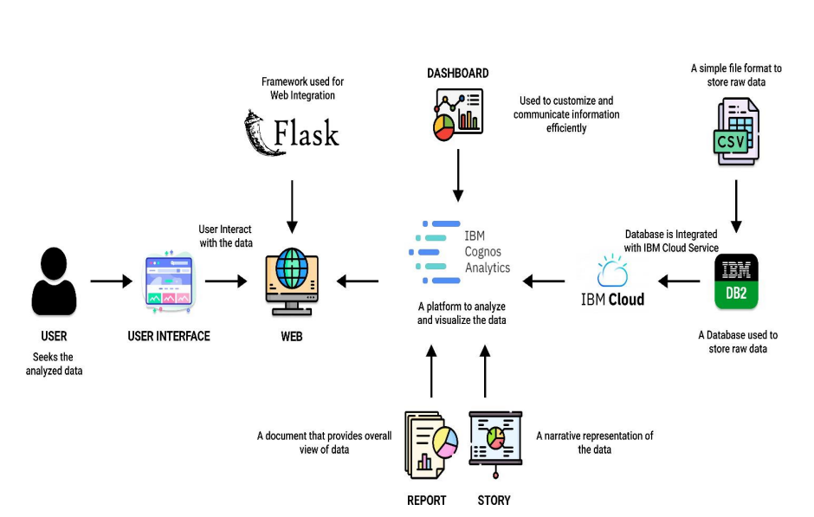
Solution architecture

Slide 7
TOOLS USED
HARDWARE REQUIREMENS
Processor
RAM
Hard Disk
:
Intel Core i3
8 GB
500 GB
:
:
SOFTWARE REQUIREMENTS
Operating System
Language Program – Tool
Web Framework :
: Windows
: HTML, CSS, JavaScript, Python
: Visual Studio Code Flask
TOOL REQUIREMENTS
Operating System
Disk Space Processor Version
: Windows 10
256 MB
Intel atom processor 3.6.2
:
:
:

Slide 8
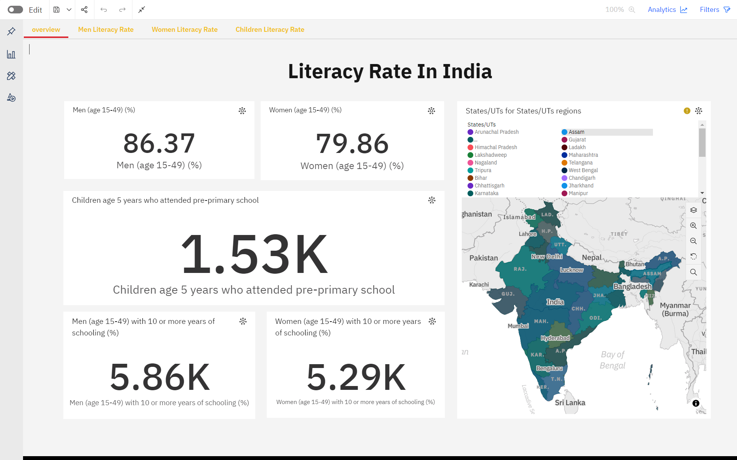
DASHBOARD

Slide 9
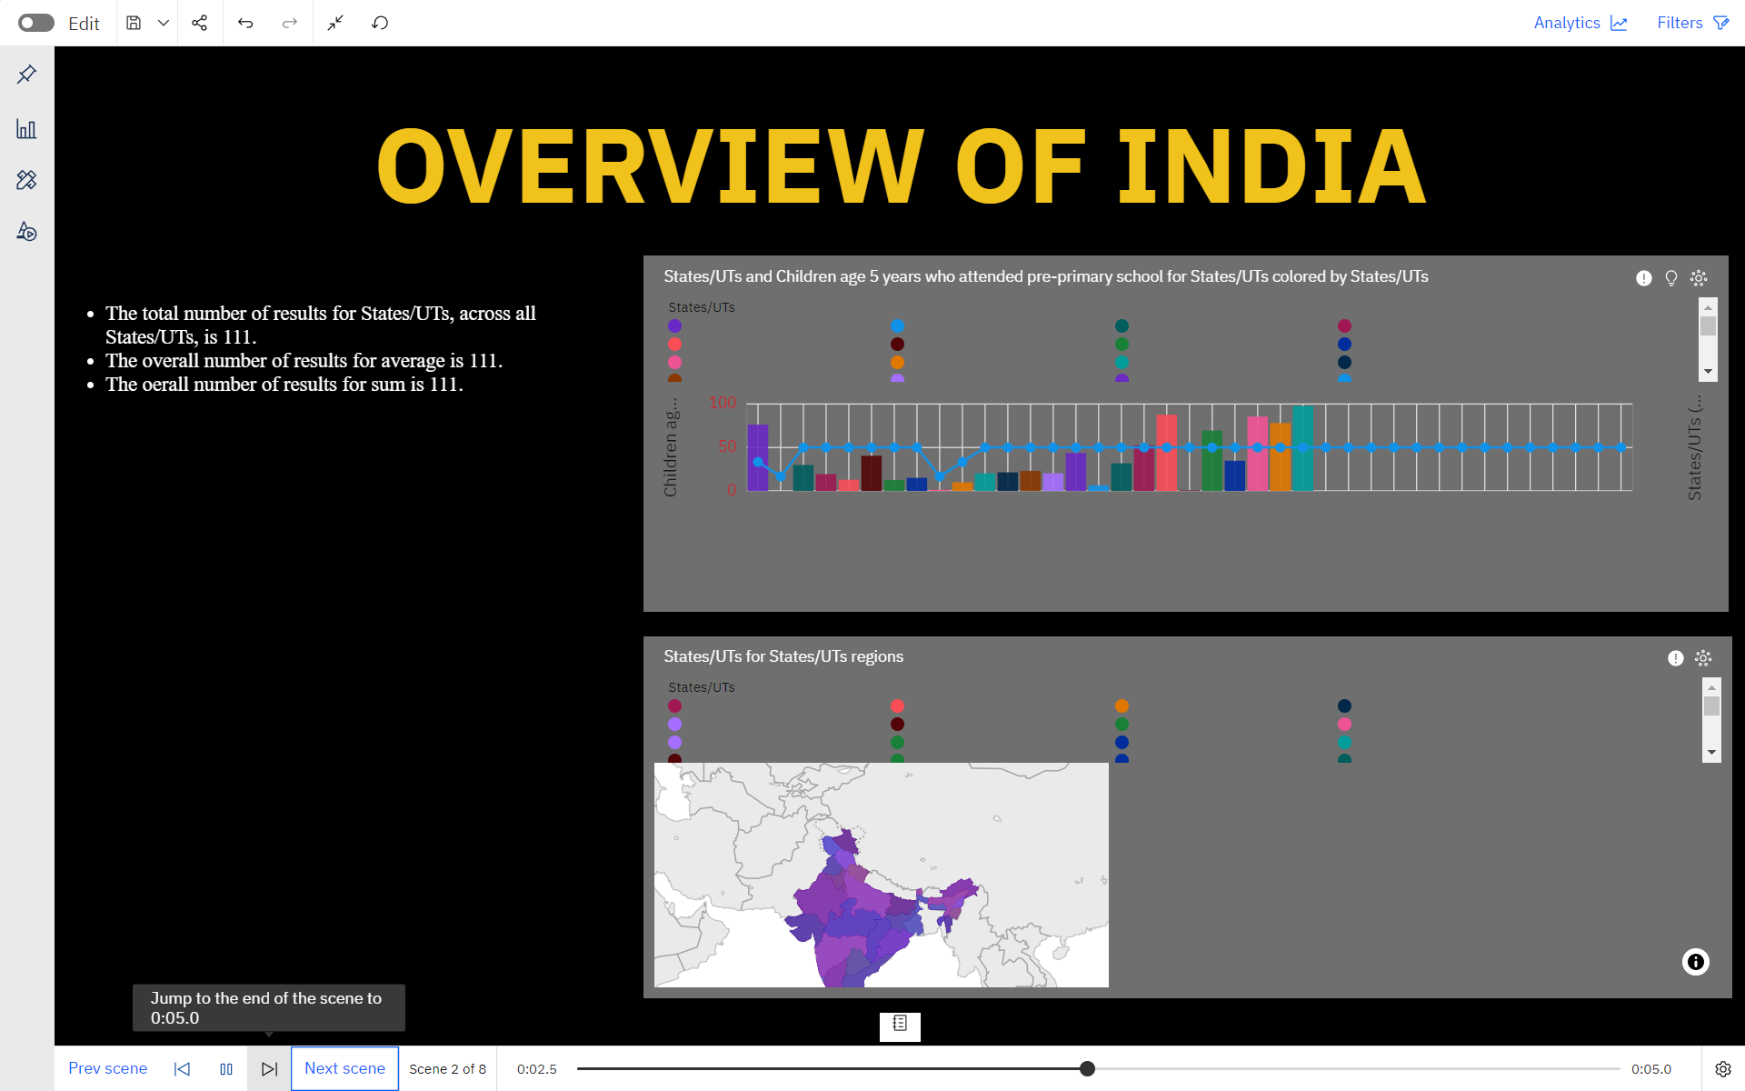
STORY

Slide 10
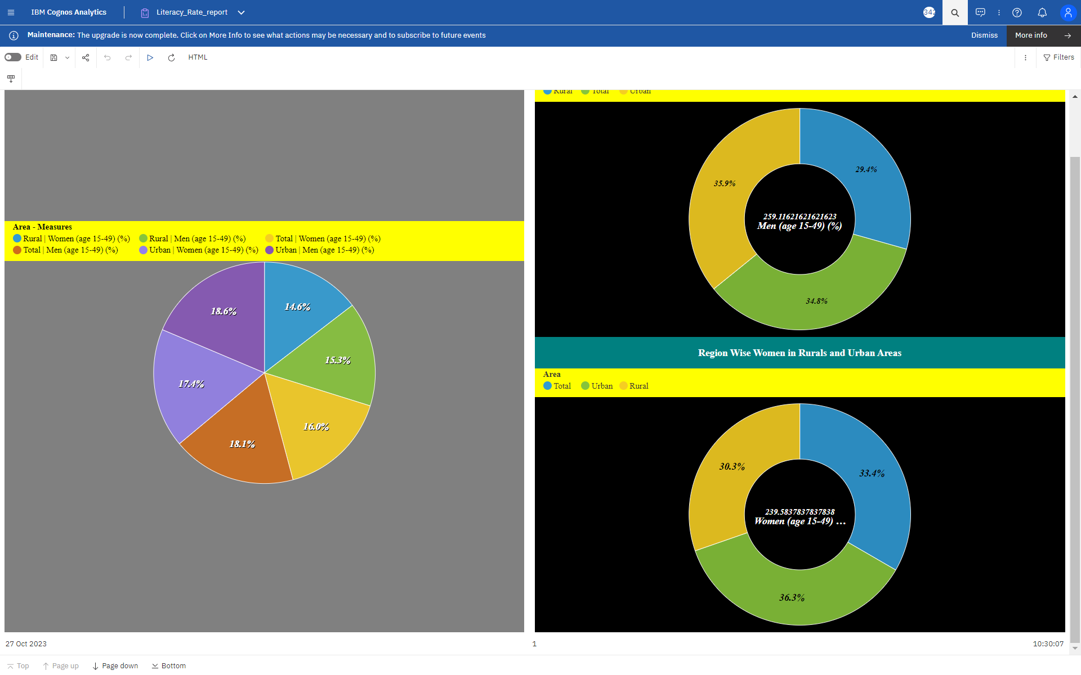
REPORT

Slide 11
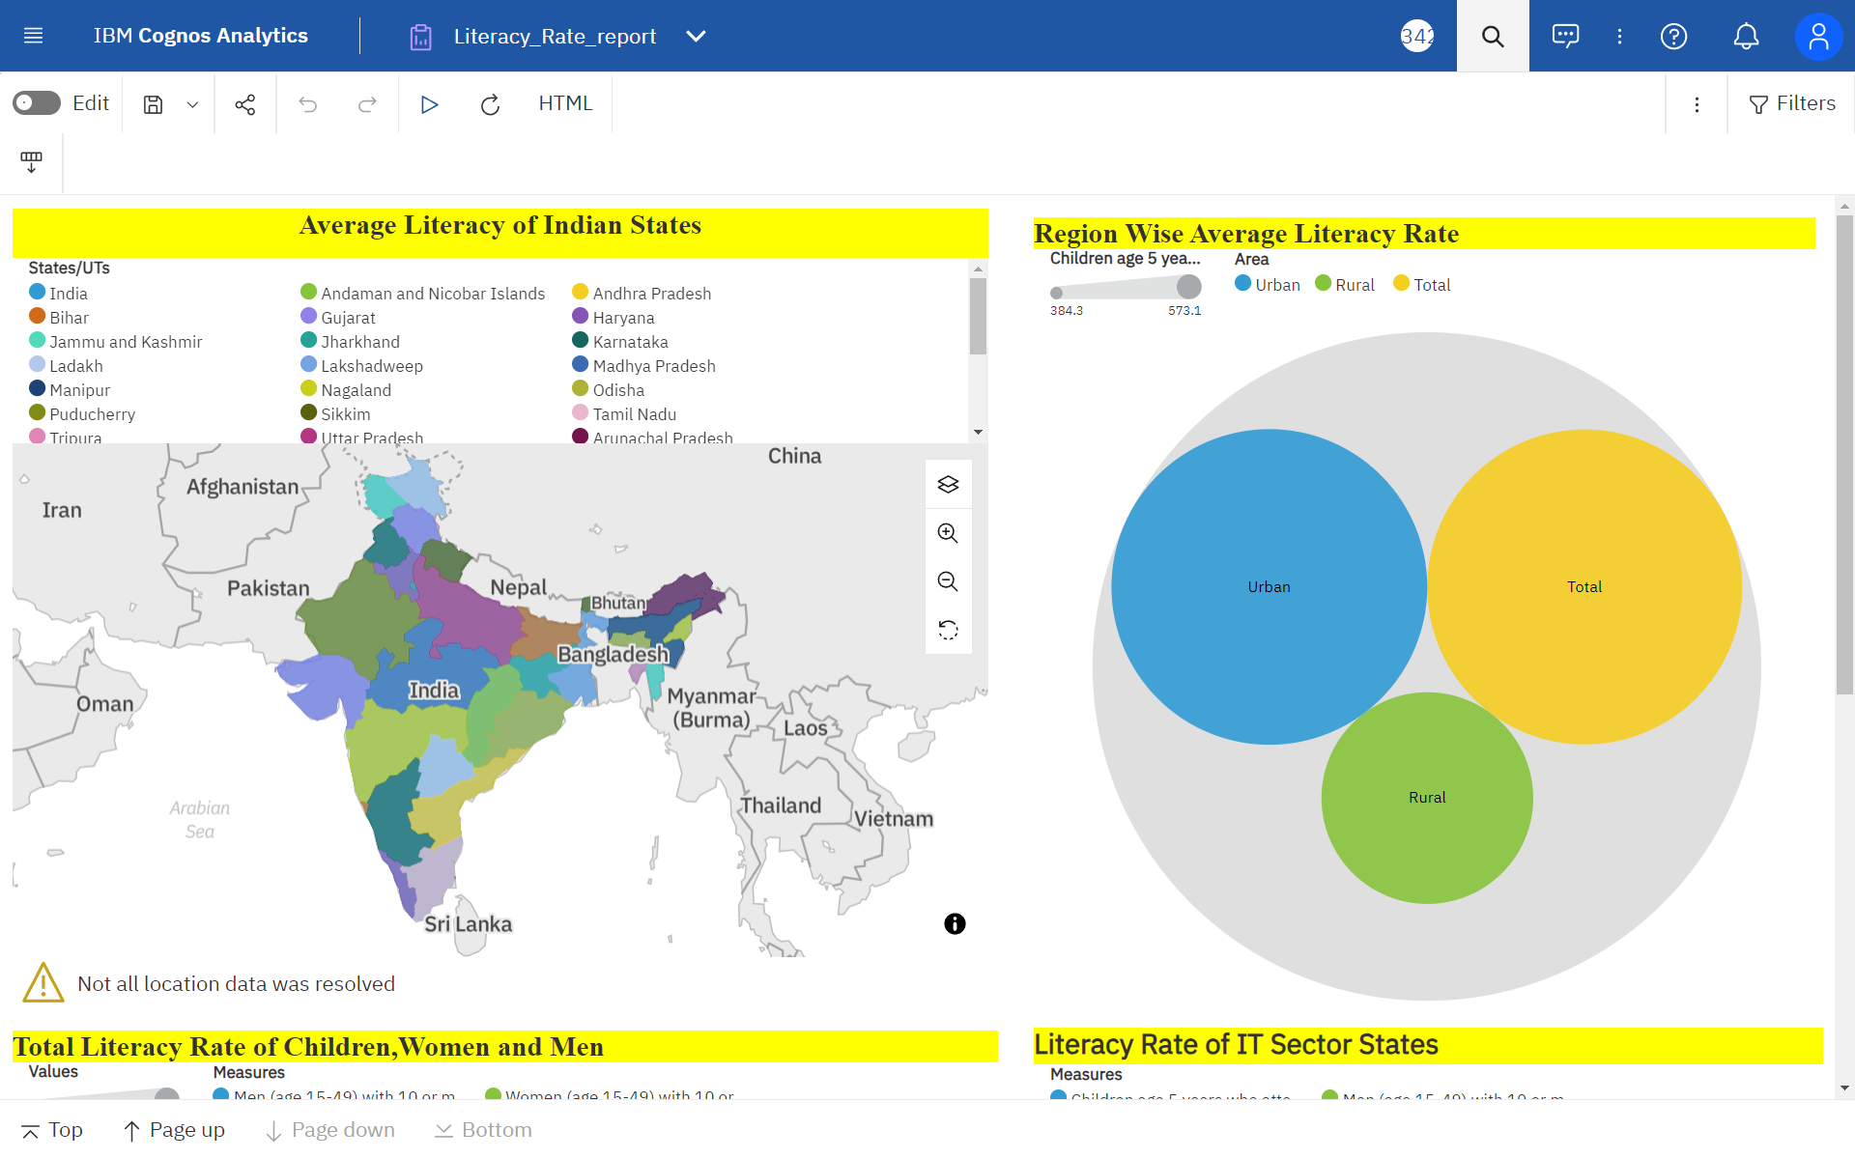
REPORT

Slide 12
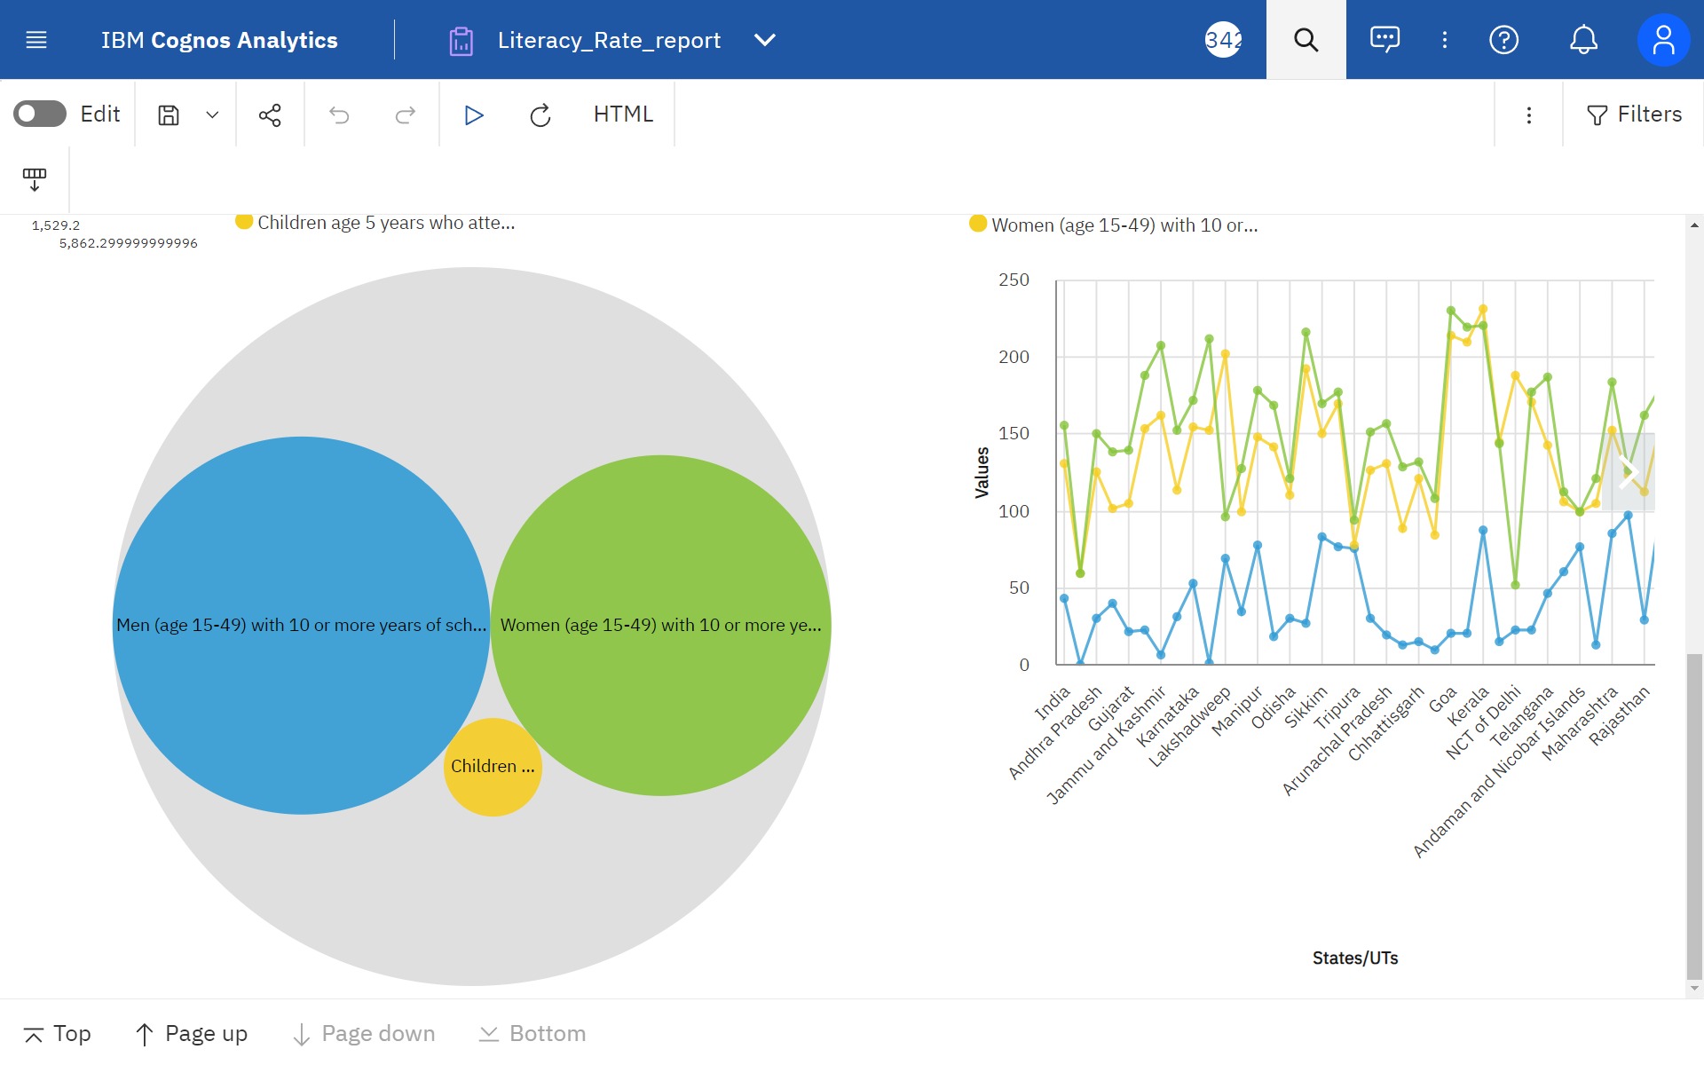
REPORT

Slide 13
THANK YOU

